Slide 1
BANA 4080 Homework 4 Review
Mike Platt
plattm@ucmail.uc.edu

Slide 2
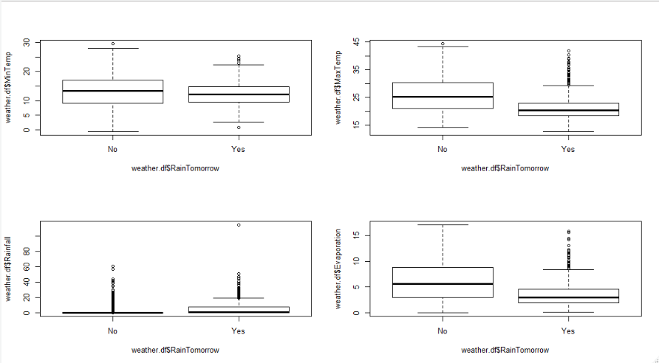
EDA: Box Plots

Slide 3
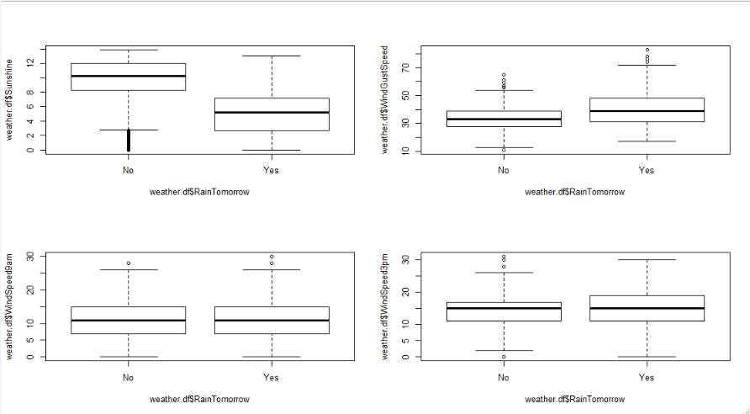
EDA: Box Plots

Slide 4
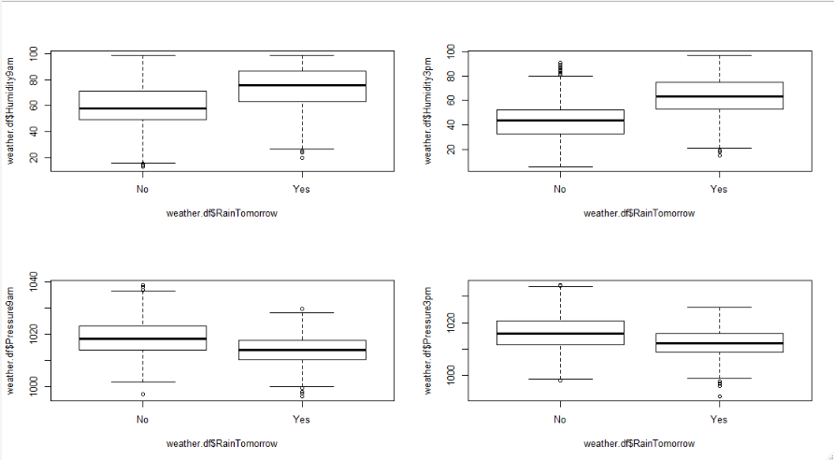
EDA: Box Plots

Slide 5
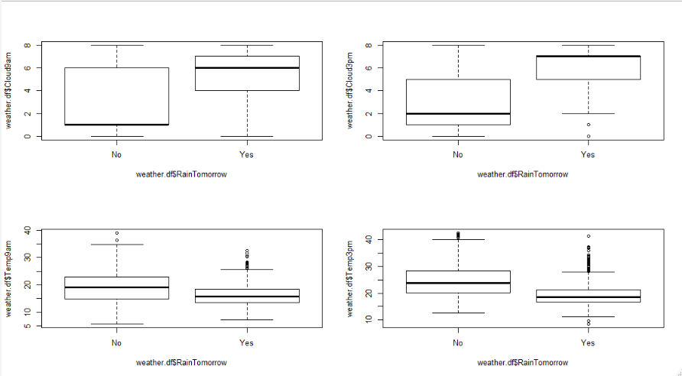
EDA: Box Plots

Slide 6
EDA: Box Plot Findings
Rainfall has a very strong positive skew
When the humidity is higher at 3PM, and when they sky is cloudy at 9AM and 3PM, it appears it is more likely to rain the next day.
When it is sunny, it is less likely to rain the next day.

Slide 7
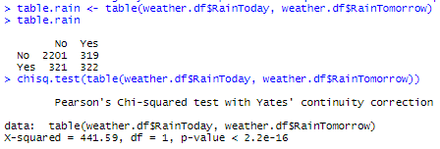
EDA: Contingency Table
We can conclude from the very small p-value for the chi-squared test that RainToday and RainTomorrow are NOT independent. There is a relationship between these two variables that is worth exploring.
In fact, I performed a chi-squared test for independence between RainTomorrow and every categorical predictor, and none turned out to independent from RainTomorrow.

Slide 8
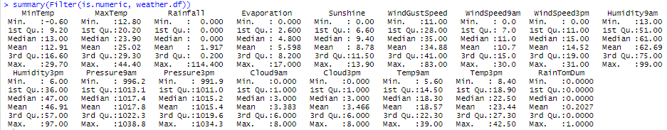
EDA: Summary Statistics - Numeric
There is no missing data.
This reinforces the high positive skew for Rainfall.
Evaporation appears to have a slight positive skew as well.
There is rain the next day 20.27% of the time.

Slide 9
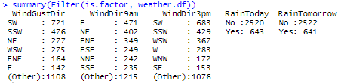
EDA: Summary Statistics - Factor
It rains today just as much as it rains tomorrow. (Shocking!)
The wind appears to consistently come from a variety of directions.

Slide 10
Pre-Processing
Converted RainTomorrow to a binary dummy variable.
Created binary dummy variables for all categorical predictors.
This resulted in 68 predictors.

Slide 11
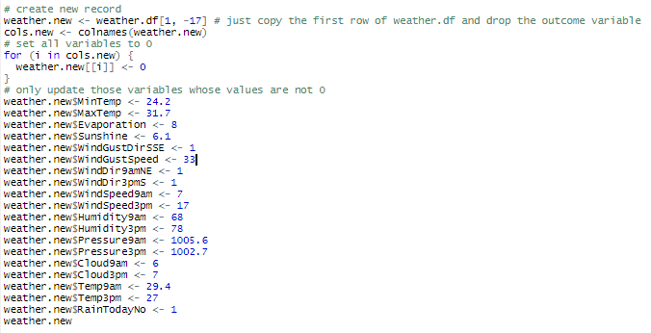
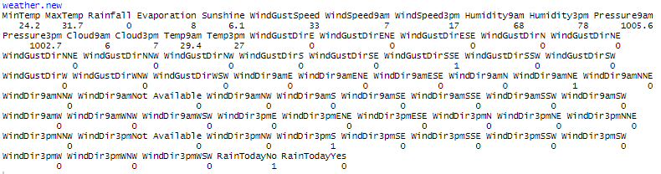
New Record
This was not a requirement of this assignment, but I have also created a new record to be classified later on in order to demonstrate some additional concepts.
MinTemp | 24.2
MaxTemp | 31.7
Rainfall | 0
Evaporation | 8
Sunshine | 6.1
WindGustDir | SSE
WindGustSpeed | 33
WindDir9am | NE
WindDir3pm | S
WindSpeed9am | 7
WindSpeed3pm | 17
Humidity9am | 68
Humidity3pm | 78
Pressure9am | 1005.6
Pressure3pm | 1002.7
Cloud9am | 6
Cloud3pm | 7
Temp9am | 29.4
Temp3pm | 27
RainToday | No

Slide 12
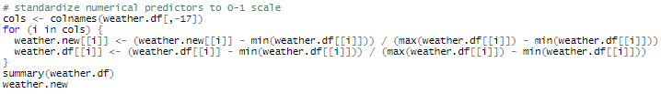
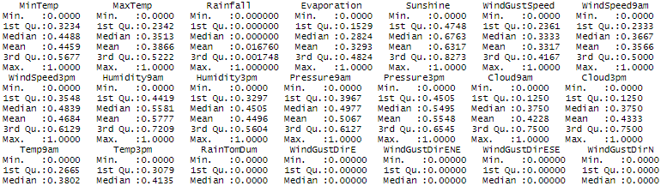
Pre-Processing - Standardize
Standardized all predictors in the full data set and the new data point to a 0-1 scale

Slide 13

Partition The Data
We then partition the data, using 60% for the training set and 40% for the validation set.

Slide 14
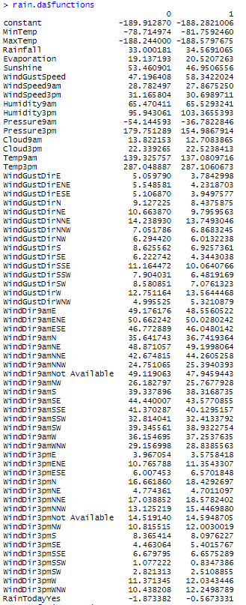

Discriminant Analysis
To the right are the classification functions that result from the discriminant analysis.

Slide 15
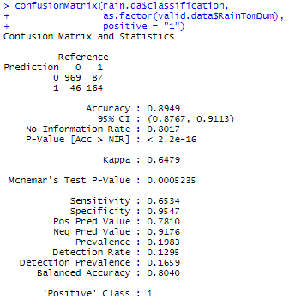
Confusion Matrix
The DA model accurately classifies 89.5% of all records.
It misclassifies rainy days at a greater rate than dry days (34.7% vs. 4.5%, respectively).

Slide 16
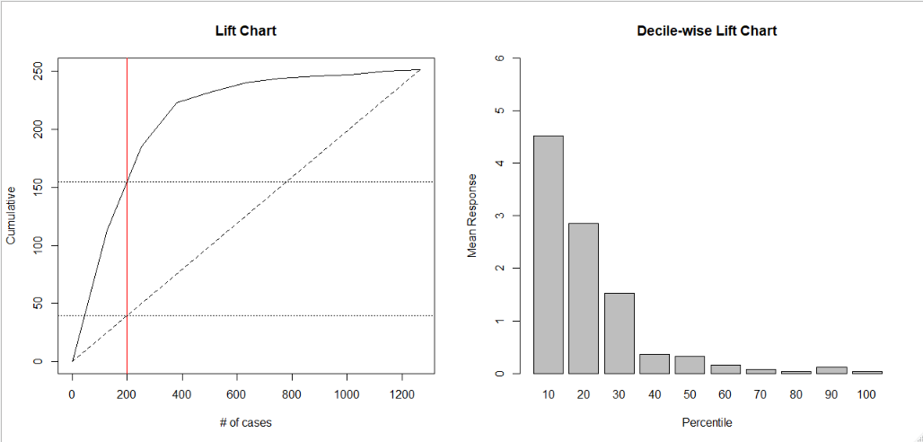
Lift Charts
The lift chart indicates that if we selected the 200 most likely rainy days, we would correctly capture ~155 actual rainy days, while if we randomly selected 200 days, we would only capture ~40 – a lift of about 3.9.
If we chose the top 10% most likely rainy days, we would capture ~4.5 times as many actual rainy days than if we’d randomly selected 10% of the records.

Slide 17
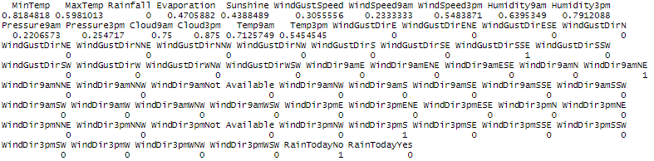
Discriminant Analysis – Classifying a New Record
Using the classification functions that resulted from the discriminant analysis (slide 14):
Rain: -188.282 + (-81.759)(0.818) + (-188.58)(0.598) + (20.521)(0.471) + (46.951)(0.439) + (58.342)(0.306) + (27.868)(0.233) + (30.699)(0.548) + (65.529)(0.64) +(103.366)(0.791) + (-36.782)(0.221) + (154.987)(0.255) + (12.708)(0.75) + (22.524)(0.875) + (137.081)(0.713) + (287.106)(0.545) + (10.064)(1) + (49.2)(1) + (8.098)(1)
= 209.421
No rain: -189.913 + (-78.715)(0.818) + (-188.244)(0.598) + (19.137)(0.471) + (53.461)(0.439) + (47.196)(0.306) + (28.782)(0.233) + (31.166)(0.548) + (65.47)(0.64) +(95.943)(0.791) + (-54.145)(0.221) + (179.751)(0.255) + (13.822)(0.75) + (22.339)(0.875) + (139.326)(0.713) + (287.049)(0.545) + (11.164)(1) + (48.871)(1) + (8.365)(1)
= 209.595
Since 209.595 > 209.421, we would predict that it will not rain tomorrow.

Slide 18
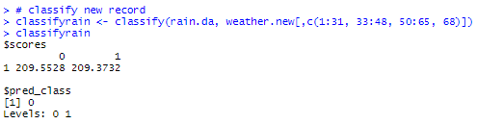
Discriminant Analysis – Classifying a New Record
Since 209.5528 > 209.3732, we would predict that it will not rain tomorrow. (The slight difference in values from the previous slide is simply due to my rounding when calculating manually.)

Slide 19
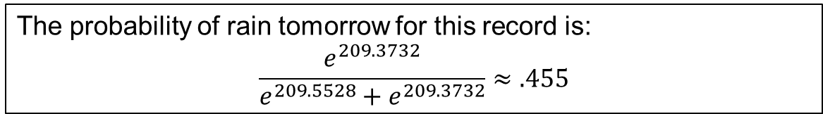
Discriminant Analysis – Classifying a New Record
The probability of rain tomorrow for this record is:
$$\frac{e^{209.3732}}{e^{209.5528}+e^{209.3732}}≈.455$$

Slide 20

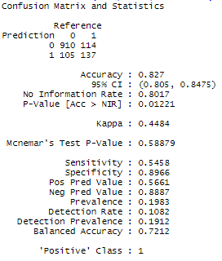
Predicting Rain – k-NN with k=1
Using k=1, we correctly classify 82.7% of all records.
We correctly classify 54.6% of rainy days, while correctly classifying 89.7% of dry days.
Of those days we predicted to be rainy, only 56.6% actually were rainy.

Slide 21
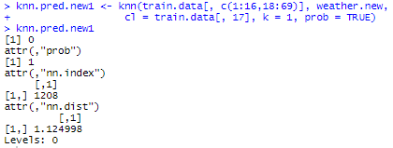
Classifying New Record with k-NN
Using k=1, the k-NN algorithm finds the single closest neighbor and classifies the new record based on the class of that neighbor (or as the majority class of the 1 nearest neighbor).
In this case, the record is classified as a “0” – it is not predicted to rain tomorrow.

Slide 22
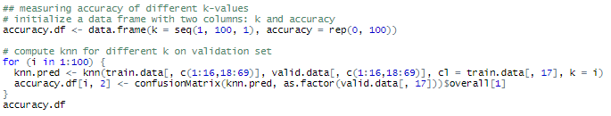
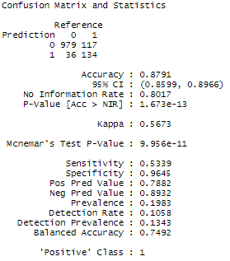
Finding the Optimal k
Here we see that the maximum accuracy of 0.879147 occurs at k=75.

Slide 23
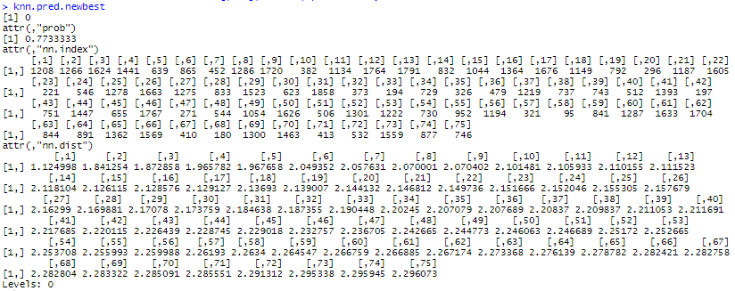
Classifying New Record Using Best k
Using k=75, the k-NN algorithm finds the 75 closest neighbors and classifies the new record based on the majority class of those 75.
Again, the record is classified as a “0” – rain is not predicted tomorrow.
The output also tells us that ~77% of the 75 nearest neighbors are 0s.

Slide 24
Summary
Model name | Description | Accuracy | Sensitivity | Specificity | Precision
rain.da | Discriminant analysis | 89.5% | 65.3% | 95.5% | 78.1%
knn.pred.1 | k-NN with k=1 | 82.7% | 54.6% | 89.7% | 56.6%
knn.pred.best | k-NN with optimal k (k=75) | 87.9% | 53.4% | 96.5% | 78.8%
Using the metrics resulting from the confusion matrices, the k-NN algorithm with k=75 performed better specifically at identifying dry days.
However, the discriminant analysis model was more accurate overall and performed better at predicting rainy days.
If our goal is exclusively to identify as many rainy days as possible, we should use the discriminant analysis model.
In reality, when we think about how rain is predicted in a weather forecast, rather than using these models to predict firmly whether or not it will rain, it would likely be more useful to use the model(s) to determine the probability that it will rain tomorrow. In this case, the discriminant analysis model will be more useful, as you can calculate probabilities using the classification scores.

